Slide 1
2-A:- Perform data loading, feature selection (Principal component analysis) and feature scoring and ranking.

Slide 2
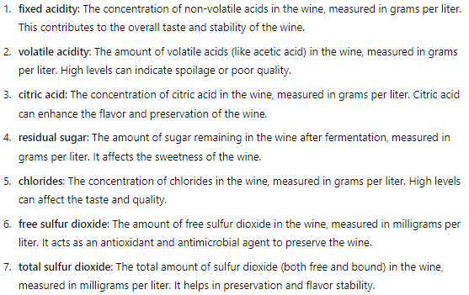
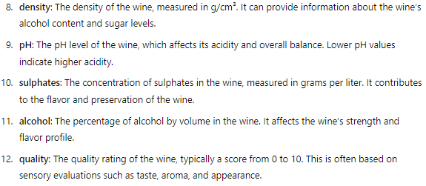

The dataset:-

Slide 3

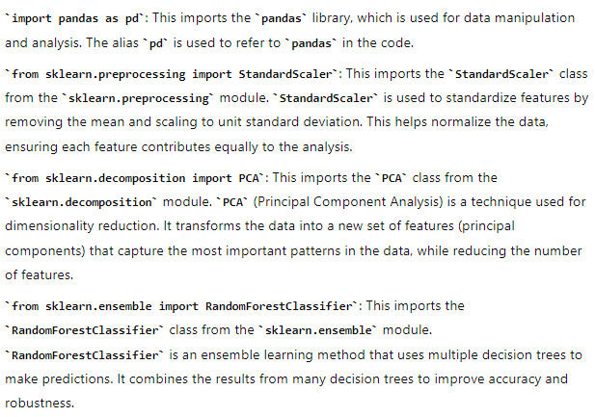

Slide 4

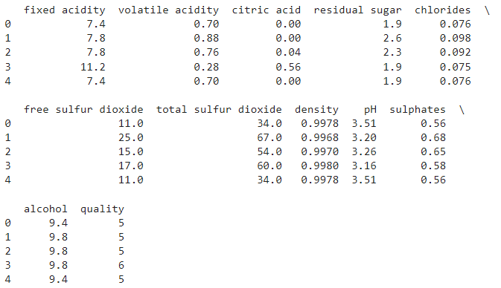


Slide 5

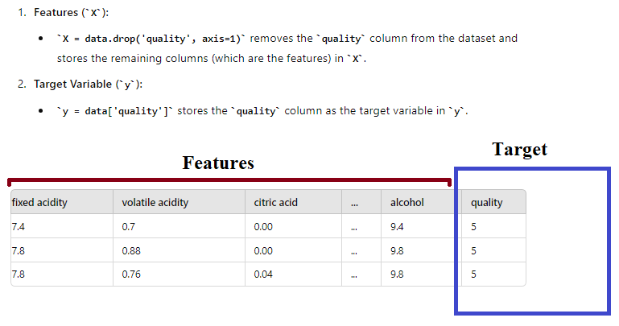

Slide 6

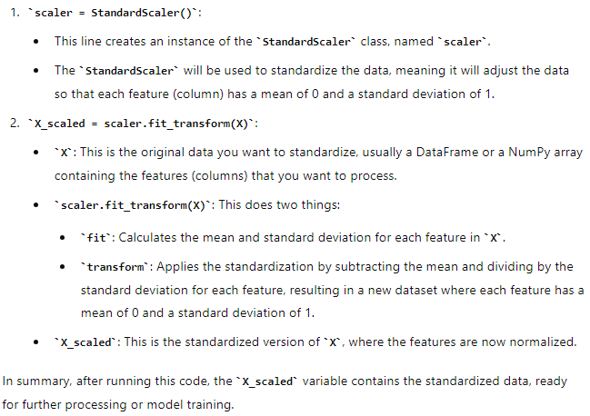

Slide 7
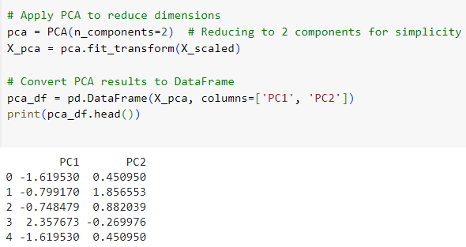
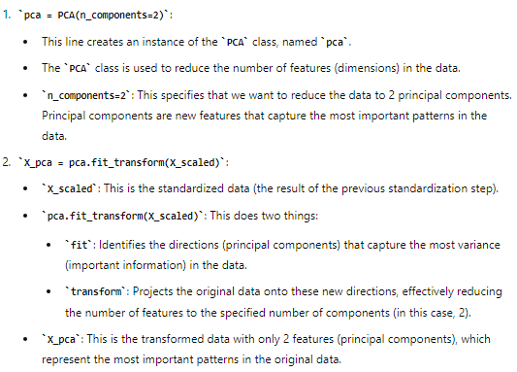

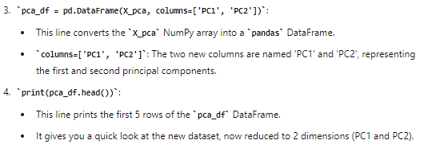

Slide 8
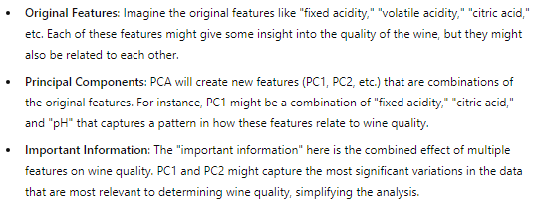


Slide 9

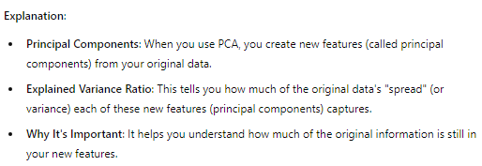
print(f"Explained variance ratio: {pca.explained_variance_ratio_}")

Slide 10
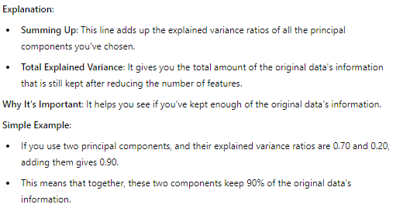
print(f"Total explained variance: {sum(pca.explained_variance_ratio_)}")

Slide 11


45%: Contains the most critical and impactful information.
55%: Represents more subtle details, which might be less important depending on your analysis needs.
So, in many cases, focusing on the 45% can give you a good understanding of the overall data while simplifying the complexity.

Slide 12

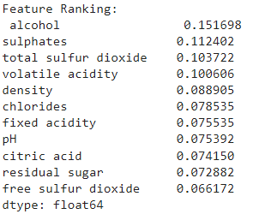
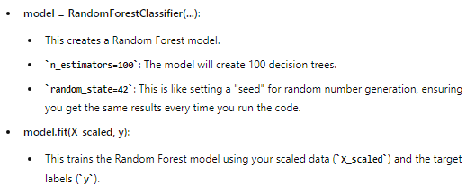
model = RandomForestClassifier(n_estimators=100, random_state=42)
model.fit(X_scaled, y)

Slide 13


feature_importance = model.feature_importances_
feature_ranking = pd.Series(feature_importance, index=X.columns).sort_values(ascending=False)

Slide 14
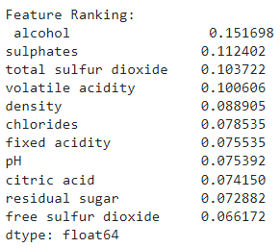
print("Feature Ranking:\n", feature_ranking)

Slide 15
2-B:- For a given set of training data examples stored in a CSV file, implement and demonstrate the candidate elimination algorithm to output a description of the set of all hypotheses consistent with the training examples.

Slide 16
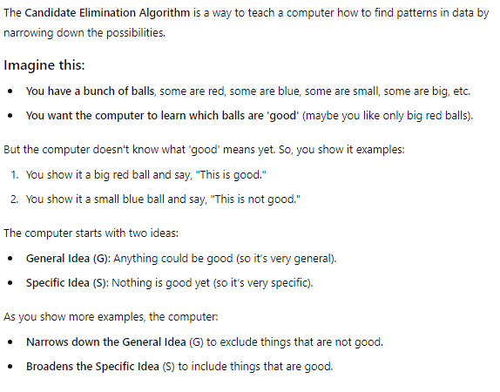

Slide 17
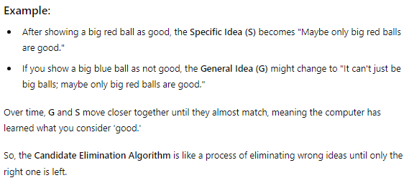

Slide 18
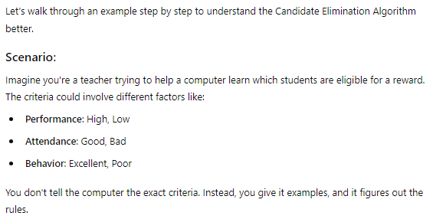
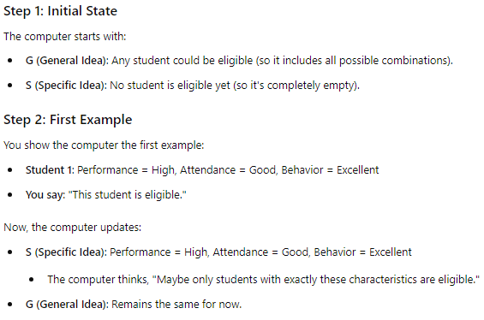

Slide 19
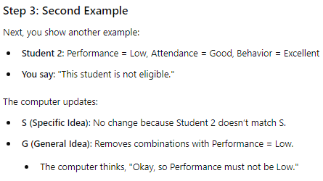
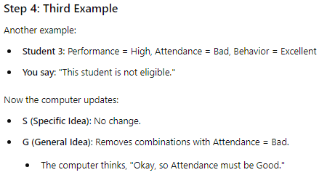

Slide 20
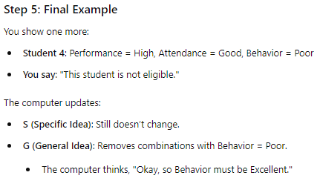


Slide 21
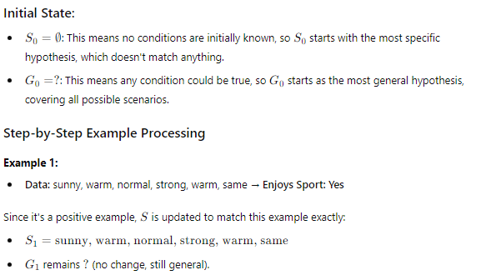
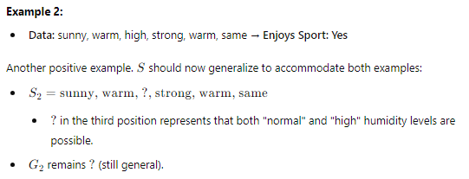

Slide 22
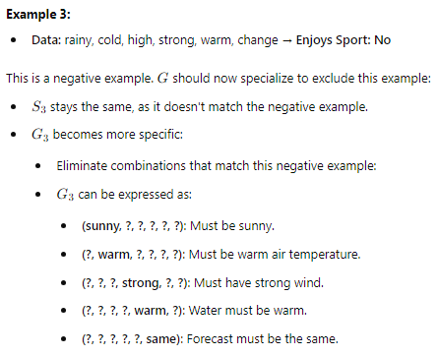
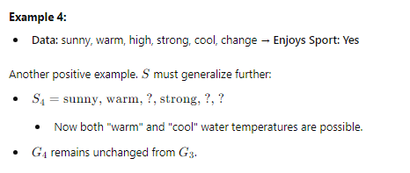

Slide 23
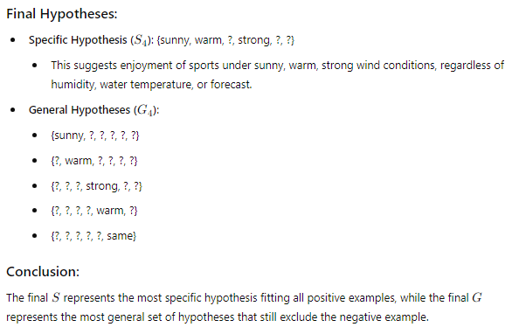

Slide 24






Slide 25





Slide 26
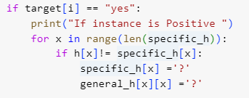
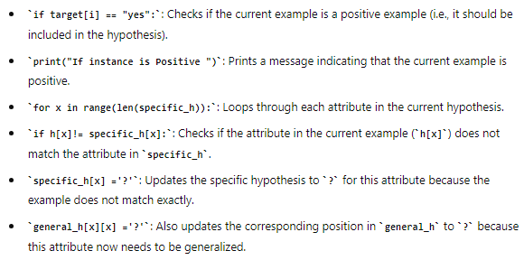

Slide 27
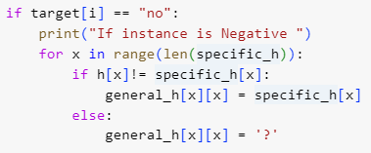
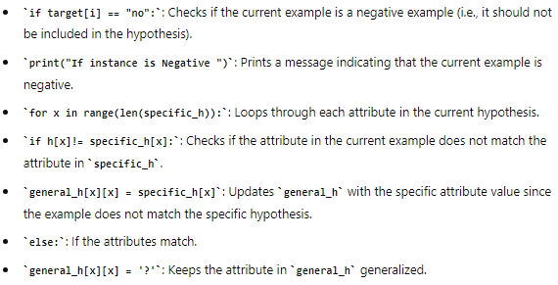

Slide 28
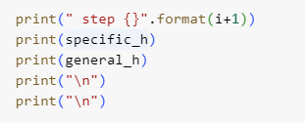


Slide 29


Slide 30



